Slide 1

THE CURA NETWORK
Caring for Students in Need
Office of the Dean of Students - SOS
Notes:
We’re going to talk about how you, as student leaders, can spot when someone might be struggling and help connect them to the right support. We’ll cover key campus resources and explain how you fit into the process. You don’t need to have all the answers or solve everything. What you can do is notice the signs, check in with care, and know how to share concerns with your supervisor so the student gets the help they need. By being that bridge, you make a big difference in helping your peers stay on track and thrive.

Slide 2

GUIDED BY THE JESUIT PRINCIPLE
OF CURA PERSONALIS,
THE OFFICE OF THE DEAN OF STUDENTS
PROVIDES COMPREHENSIVE SUPPORT
AND RESOURCES TO ALL STUDENTS
BY FOSTERING A CULTURE OF CARE,
SELF-EFFICACY, ACCOUNTABILITY, AND
HOLISTIC STUDENT DEVELOPMENT.
Notes:
ODOS Mission

Slide 3
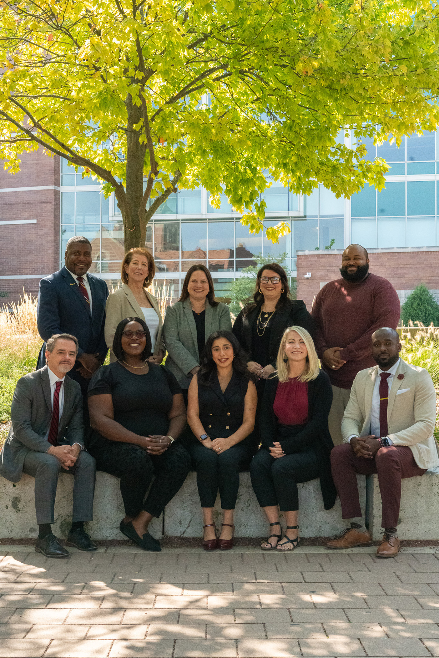
Office of the
Dean of Students
Together, we address the personal, academic, and
behavioral challenges that may impact student success.
SOS - Student Outreach & Support
Crisis intervention, case management, basic needs, holistic support (BCT/CARE)
SRCR - Student Rights, Responsibilities
& Conflict Resolution
Conduct, conflict resolution, restorative practices (Community Standards/Student Promise)
Notes:
At Loyola, we understand students are whole people – not just here to learn. That’s why the Office of the Dean of Students (ODOS) supports students through both academic and personal challenges that can affect success.
ODOS is made up of two core teams that work closely together:
Student Outreach & Support (SOS)
We support students facing urgent crises or ongoing personal challenges; everything from mental health struggles and grief to financial stress or basic needs, through:
The CARE team (personal support and case management)
The Behavioral Concerns Team (BCT) (early response and ongoing support to concerning or disruptive behavior)
Basic needs support like food, housing, and emergency funding
2. Student Rights, Responsibilities & Conflict Resolution (SRCR)
SRCR handles student conduct and conflict resolution, including restorative practices. If a situation involves policy violations, roommate issues, or interpersonal conflict, students meet with SRCR.
Though we have different roles, both SOS and SRCR work toward the same goal: helping students move through challenges while promoting well-being, learning, and a sense of belonging.
We also respond to urgent situations through the Dean on Call and assess serious risks through the Threat Assessment Team.

Slide 4

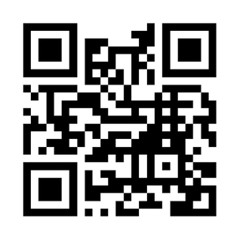
One referral can make a difference.
Support Starts Here
In the spirit of cura personalis—a hallmark of Ignatian spirituality that calls us to care for the whole person—the CURA Network is a university-wide system for identifying, referring, and responding to student concerns.
Led by the Office of the Dean of Students (ODOS), the CURA Network allows faculty, staff, and others to report academic, emotional, or personal concerns. Our team then connects students to the right support through case management, advocacy, and campus or community resources.
Our team works to connect students with the care they need, when they need it—so no student faces challenges alone.
Notes:
To make support easier and more efficient, we use the CURA Network, a secure, centralized platform where faculty, staff, families, and students can report concerns they notice. These could be related to academics, personal struggles, safety, or discrimination.
When a referral is submitted through CURA, it’s routed to the appropriate team, who then reaches out directly to the student.

Slide 5

CURA Network
BEHAVIORAL CONCERNS: BCT
Refer students whose behavior presents a possible threat to safety or well-being of oneself or others (e.g., suicide ideation, self-harm, violence or threats against others).
OFFICE OF THE DEAN OF STUDENTS - SOS
PERSONAL CONCERNS: CARE
Refer students who may need general assistance overcoming serious or complex personal difficulties or getting connected to resources. Examples include: students struggling with general mental health concerns or food/ housing insecurity, or managing a unique personal financial emergency.
OFFICE OF THE DEAN OF STUDENTS - SOS
HARASSMENT & SEXUAL
MISCONDUCT CONCERNS
Report alleged or suspected discrimination, sexual
misconduct, or equity-based retaliation by or against
any student or employee. Examples include reports of
sexual assault, stalking, dating/domestic violence,
and harassment/misconduct of any kind motivated by
an individual’s membership in a protected class.
OFFICE FOR EQUITY & COMPLIANCE (OEC)
OFFICE OF THE DEAN OF STUDENTS
STUDENT CONDUCT & CONFLICT CONCERNS
Report student conflict(s) and/or alleged violations of Loyola’s Community Standardst
OFFICE OF THE DEAN OF STUDENTS - SRCR
ACADEMIC CONCERNS
Report concerns about academic performance,
class attendance, or general academic engagement
STUDENT ACADEMIC SERVICES
and COLLEGES/SCHOOLS
Notes:
Referrals are routed to different support teams based on the type of concern:
Academic Support: For attendance, disengagement, or academic struggles
Equity & Title IX: For concerns related to harassment, discrimination, or bias
Student Rights & Conflict Resolution (SRCR): For conduct issues or interpersonal conflict
You’ll hear more about these areas from each of those teams.
Today, we are going to focus on what happens when concerns involve the CARE team or the Behavioral Consultation Team (BCT).

Slide 6


Behavioral
Concerns Team (BCT)
A multi-disciplinary committee that serves as the centralized and coordinated body for discussion and action regarding students exhibiting behaviors that may:
a)present a danger to oneself or others
b)cause a disturbance in the community, and/or
c)indicate some form of distress
Notes:
AM
The Behavioral Concerns Team (BCT) is part of the Office of the Dean of Students and focuses on early response to serious or escalating concerns - especially when a student might be in emotional distress, experiencing conflict, or showing signs of risk to themselves or others.
BCT brings together staff from different departments to assess situations and coordinate timely support which could include a check-in, connecting the student with counseling, or a wellness safety check.

Slide 7

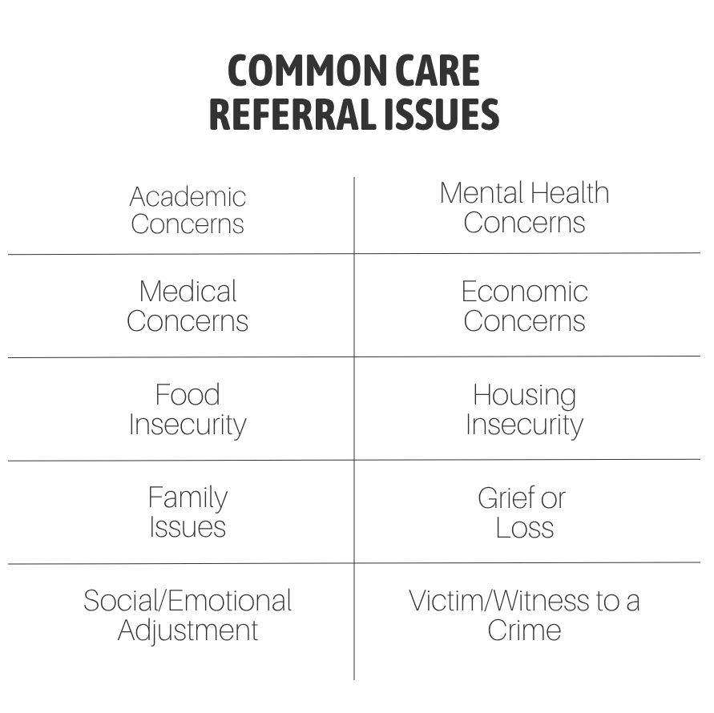
CARE Services
Supports students experiencing serious or complex personal difficulties
Provides individualized case management and personalized support
Connects students with campus and community resources
Offers ongoing follow-up, planning, and advocacy
Helps students navigate university systems during life disruptions
Notes:
AM
CARE is the university’s primary case management program, supporting students who are experiencing significant life disruptions. These can be expected challenges, like academic stress, or unexpected events, such as illness, loss, or financial hardship. CARE provides individualized support, helping students access both campus and community resources—and offering ongoing follow-up to make sure they stay connected and supported.
Examples of situations that often lead to a CARE referral include: Grief or loss of a loved one, Mental health challenges, Financial emergencies, Ongoing illness or hospitalization
Through outreach, CARE offers:
One-on-one case management for students navigating personal crises
Connections to relevant resources, both on and off campus
Ongoing planning, advocacy, and follow-up to keep students moving forward
The goal is to make sure no one has to navigate a hard situation alone.

Slide 8

Basic Needs Support
FOOD
HOUSING
EMERGENCIES
Free food pantries on all 3 campuses for enrolled students.
Short-term emergency housing assistance via Dean on Call.
One-time financial support through the CARE Fund
Notes:
AM
We also know students can’t thrive academically if their basic needs aren’t being met. That’s why CARE helps connect students to support for food, housing, and emergency financial needs.
Food: Three campus pantries (Iggy’s Cupboard, HSC Pantry, Arrupe Market) are open to all enrolled students.
Emergency Housing: For urgent needs, students can contact Campus Safety to reach the Dean on Call. For less urgent situations, share concerns with your supervisor, who can initiate support through our office.
CARE Fund: Offers short-term financial help for unexpected emergencies (like job loss, illness, or housing needs). It's not for ongoing expenses, but it can help with essentials like food, books, or transportation.

Slide 9

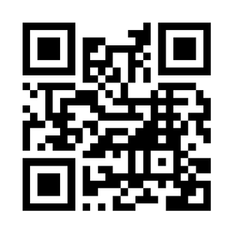
CONNECT WITH ODOS
Main Office
Email
Telephone
QR Code
Damen Student Center,
Suite 300
deanofstudents@luc.edu
773.508.8840

Slide 10

Thank You!
Notes:
Thank you for being the eyes, ears, and heart of our campus. Your care and willingness to step in truly make a difference in the lives of your peers.

